Slide 1


ITBIS
AI-POWERED INSIDER THREAT DETECTION AND BEHAVIORAL SECURITY INTELLIGENCE PLATFORM

Slide 2



Technology Stack: The ITBIS Framework
PostgreSQL
MongoDB: Behavioral Telemetry
Python and FastAPI: The Backend
Next.js and React: The Frontend
PostgreSQL: Structured Data Storage
Stores flexible activity logs, behavioral evidence, and related telemetry for security analysis.
Builds responsive, interactive security dashboards for employees, alerts, incidents, and activity monitoring.
Provides REST APIs for authentication, role-based access, activity ingestion, analytics, and incident workflows.
Node.js lets developers use JavaScript to write command line tools and server-side scripting

Slide 3
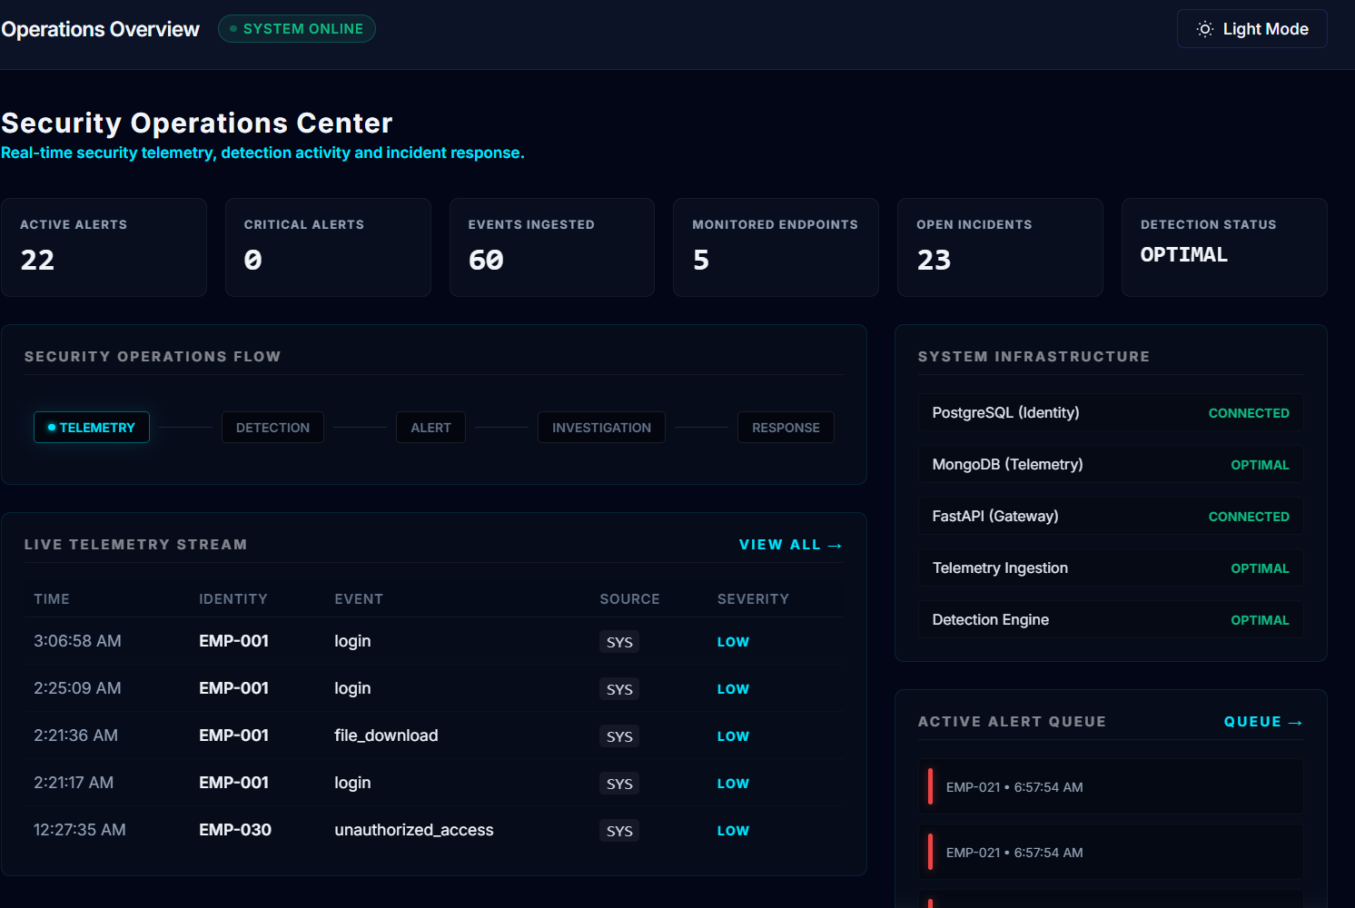
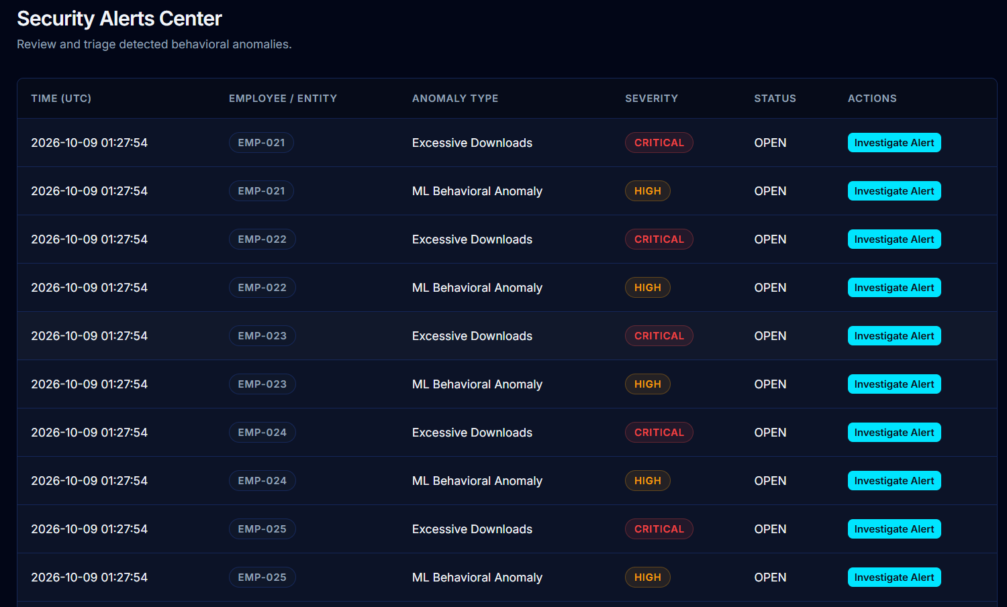
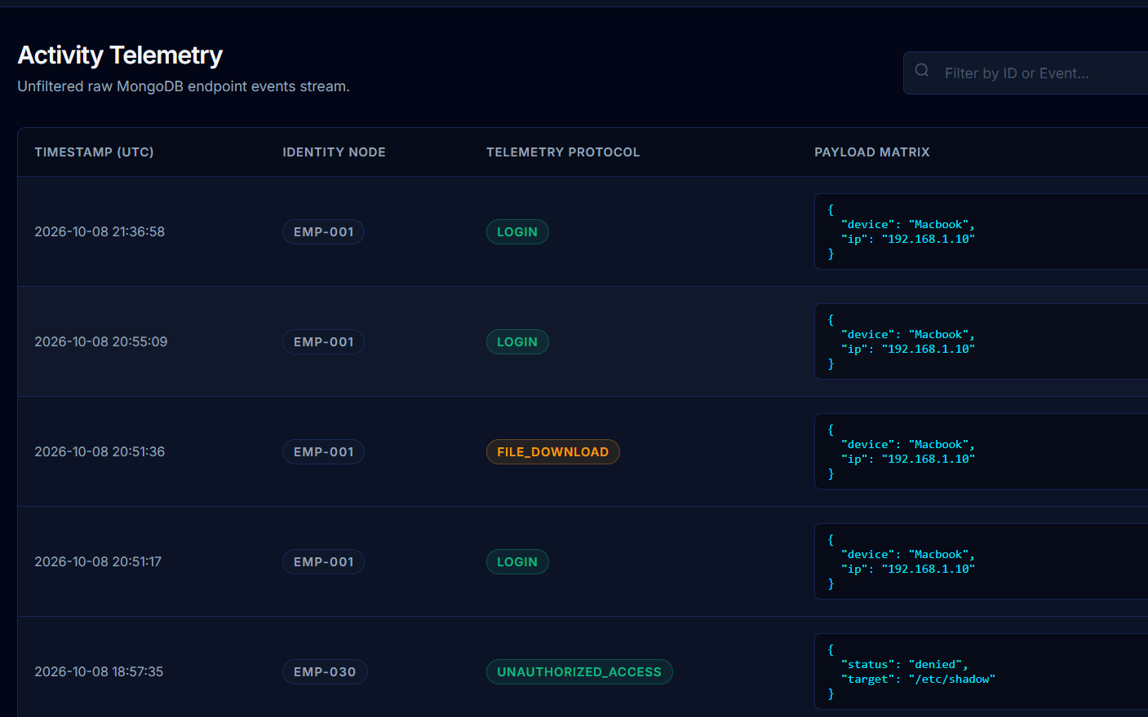
Core Features of the ITBIS Platform
Risk and Incident Management
AI-Assisted Anomaly Detection
Behavioral Activity Monitoring
Monitors employee risk scores, manages security alerts, and supports incident investigation and response tracking
Uses rule-based detection and Isolation Forest machine learning to identify unusual behavioral patterns for security review.
Collects and reviews employee-linked security events such as logins, file access, and downloads.

Slide 4
Challenges in Insider Threat Detection
1
2
Unknown Behavioral Deviations
Limited Behavioral Visibility
Traditional monitoring may miss unusual activity when events are not considered alongside normal behavior and available context.
Security-relevant activity can be scattered across systems, making it difficult to build a clear view of employee behavior and investigate unusual events.
3
4
Alert Overload
Fragmented Investigations
Security teams may receive many alerts and need a consistent way to prioritize which events require closer investigation.
Connecting telemetry, alerts, evidence, and incident records helps investigators review related events through a more organized workflow.

Slide 5
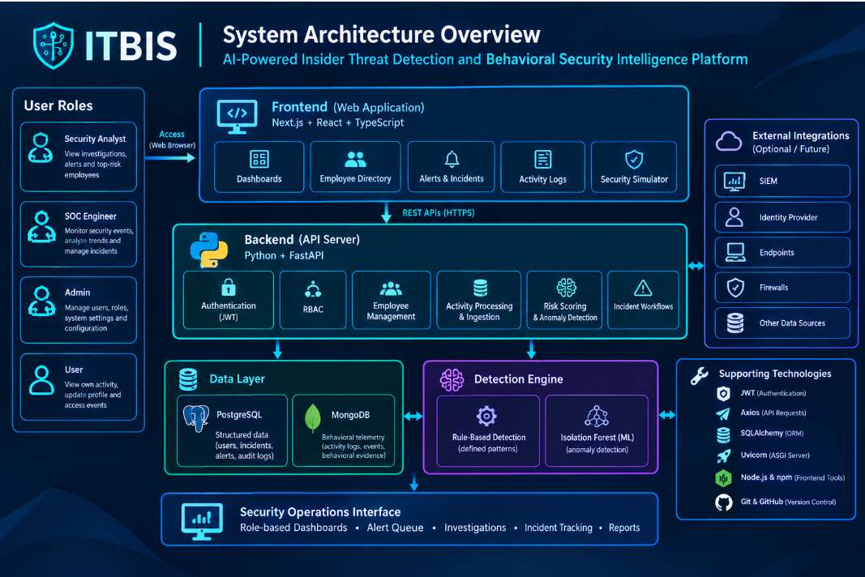
I

Slide 6
Challenges and Solutions in ITBIS
1
2
Secure Role-Based Access
Behavioral Visibility
JWT authentication and role-based permissions help restrict sensitive operations to authorized platform roles.
Centralized ingestion links security events to employees and makes available telemetry easier to review.
3
4
Intelligent Detection
Investigation Workflow
Rule-based checks and supported anomaly analysis help identify suspicious patterns for security review.
A modular architecture not only simplifies updates but also facilitates integration with third-party services, ensuring flexibility and future-proofing the platform as new technologies emerge.

Slide 7
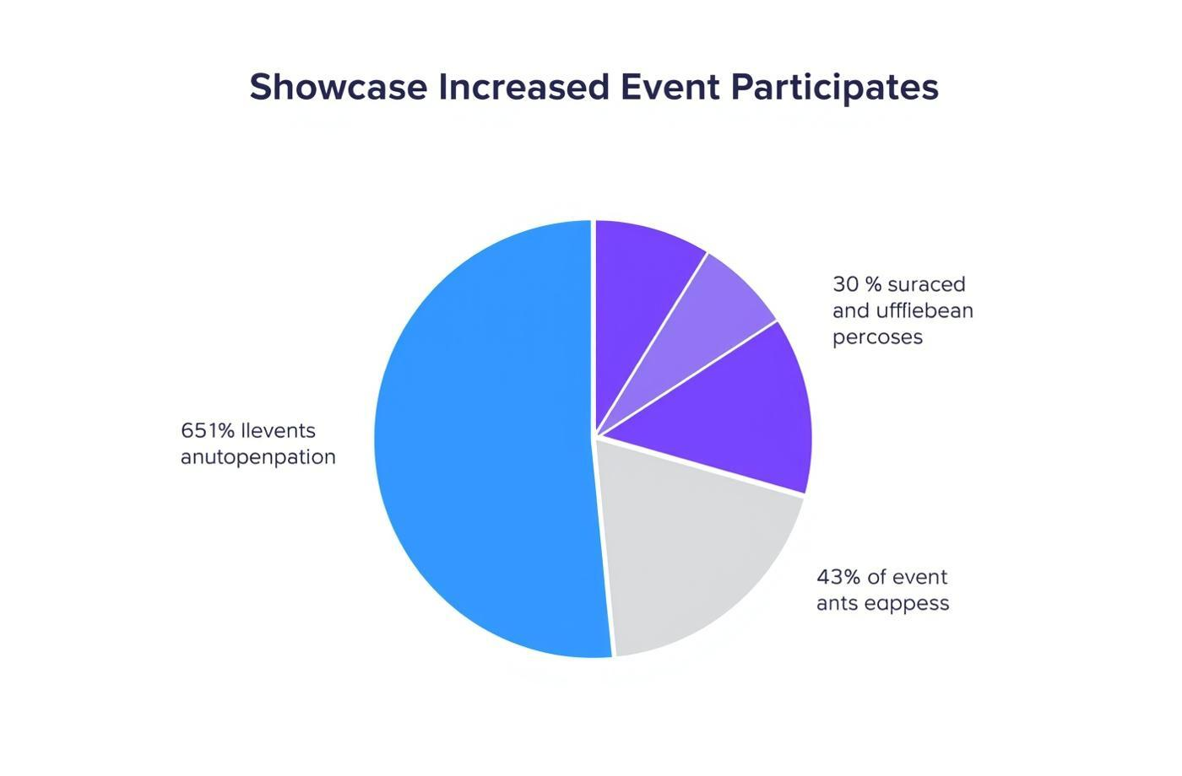
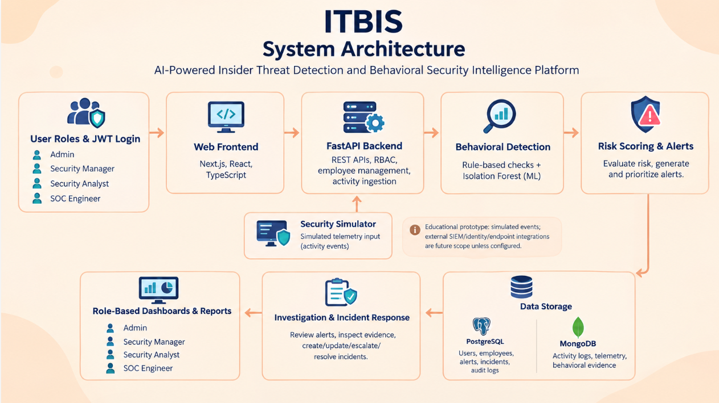

Project Outcomes and Expected Impact
Structured Incident Response
Better Risk Prioritization
Improved Behavioral Visibility
Connected alert and incident records provide a structured way to investigate and track security cases.
Risk assessment and anomaly findings help highlight activity that may need closer investigation.
A unified view helps security personnel review employee activity and related security events.

Slide 8
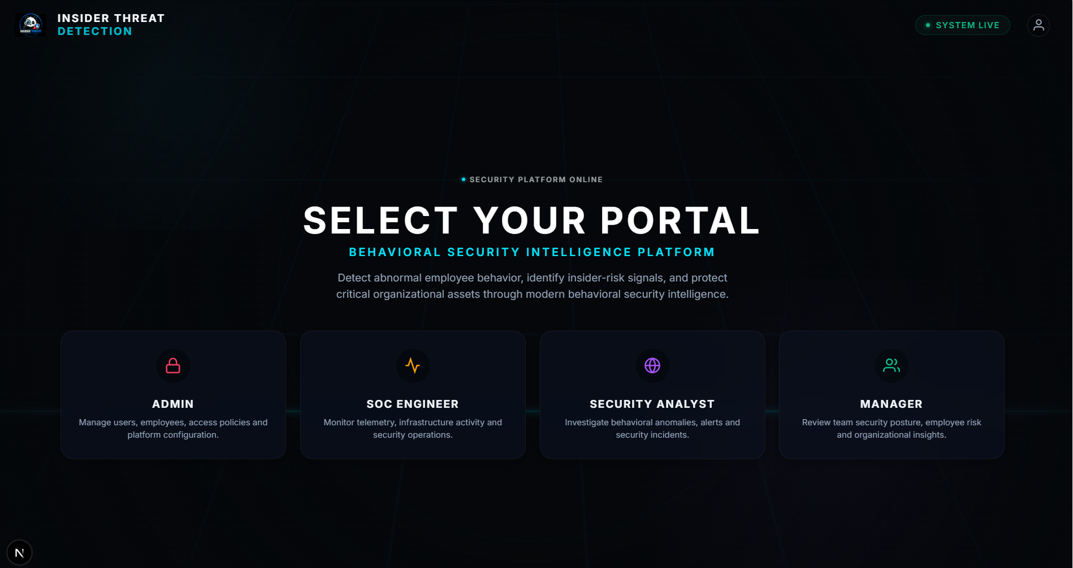
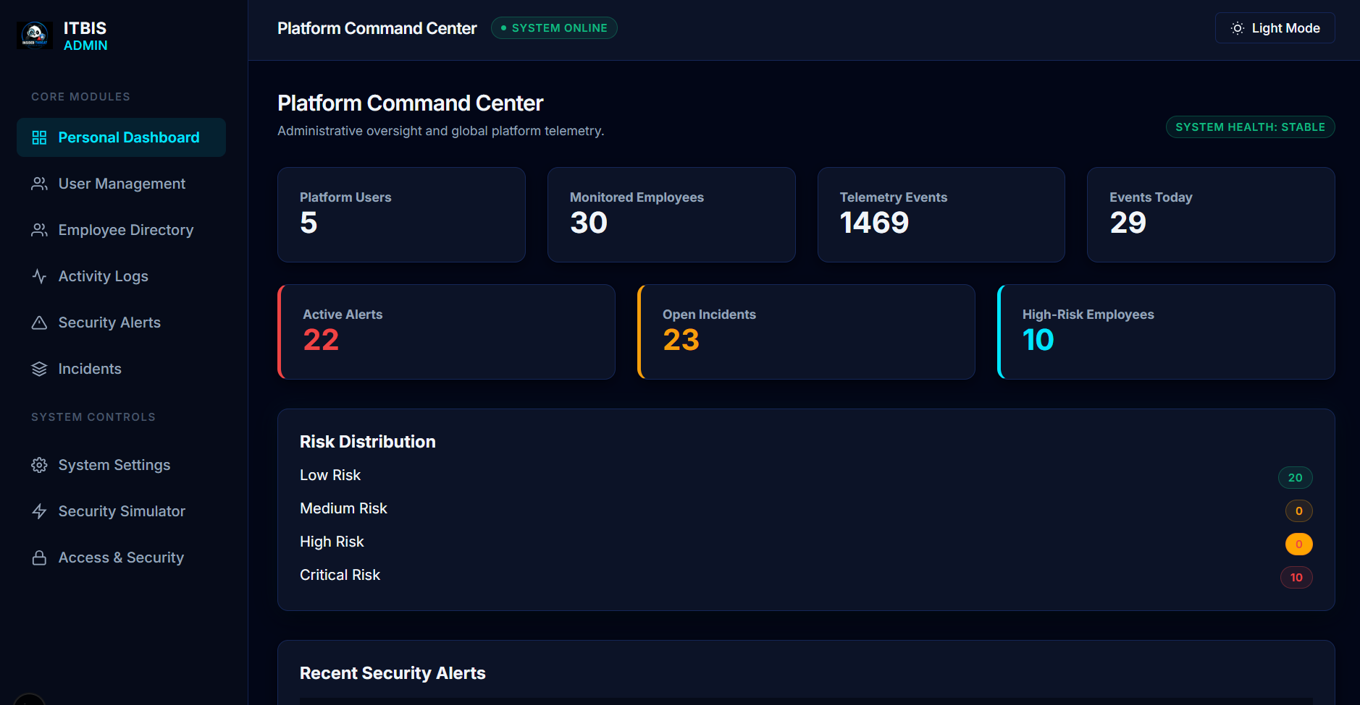
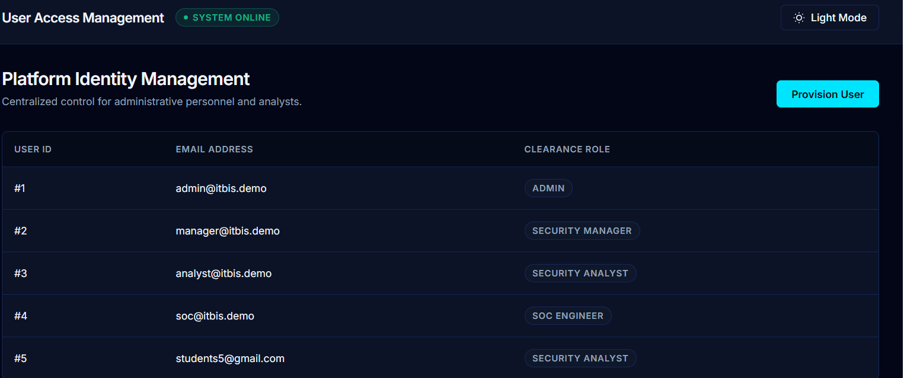
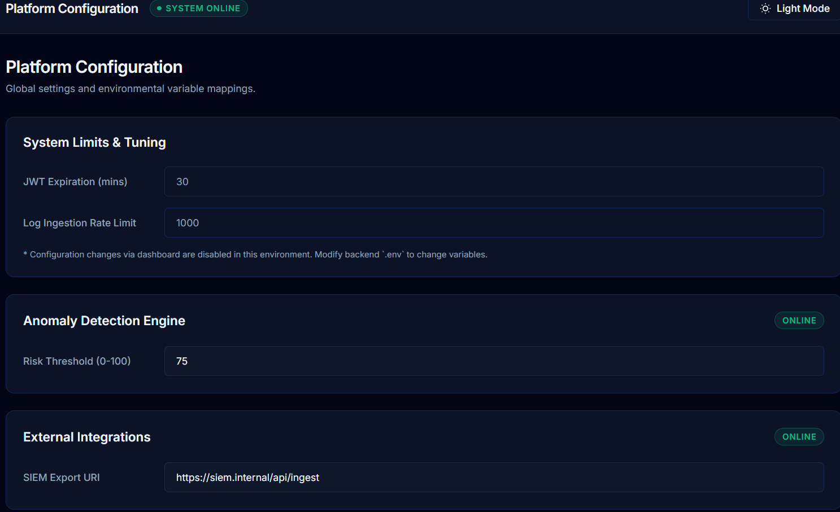
These mock-ups showcase a seamless experience for users, enhancing engagement through intuitive design and functionality.

Slide 9

ITBIS Security Operations Workflow
Stage 01 — Activity Ingestion
Activity events are submitted through the ingestion API or the security simulator.
Stage 02 — Behavioral Analysis
Available events are evaluated using configured detection rules and supported machine-learning analysis.
Stage 03 — Investigation and Response
Authorized personnel review alerts, investigate evidence, and update or escalate incidents where supported.

Slide 10

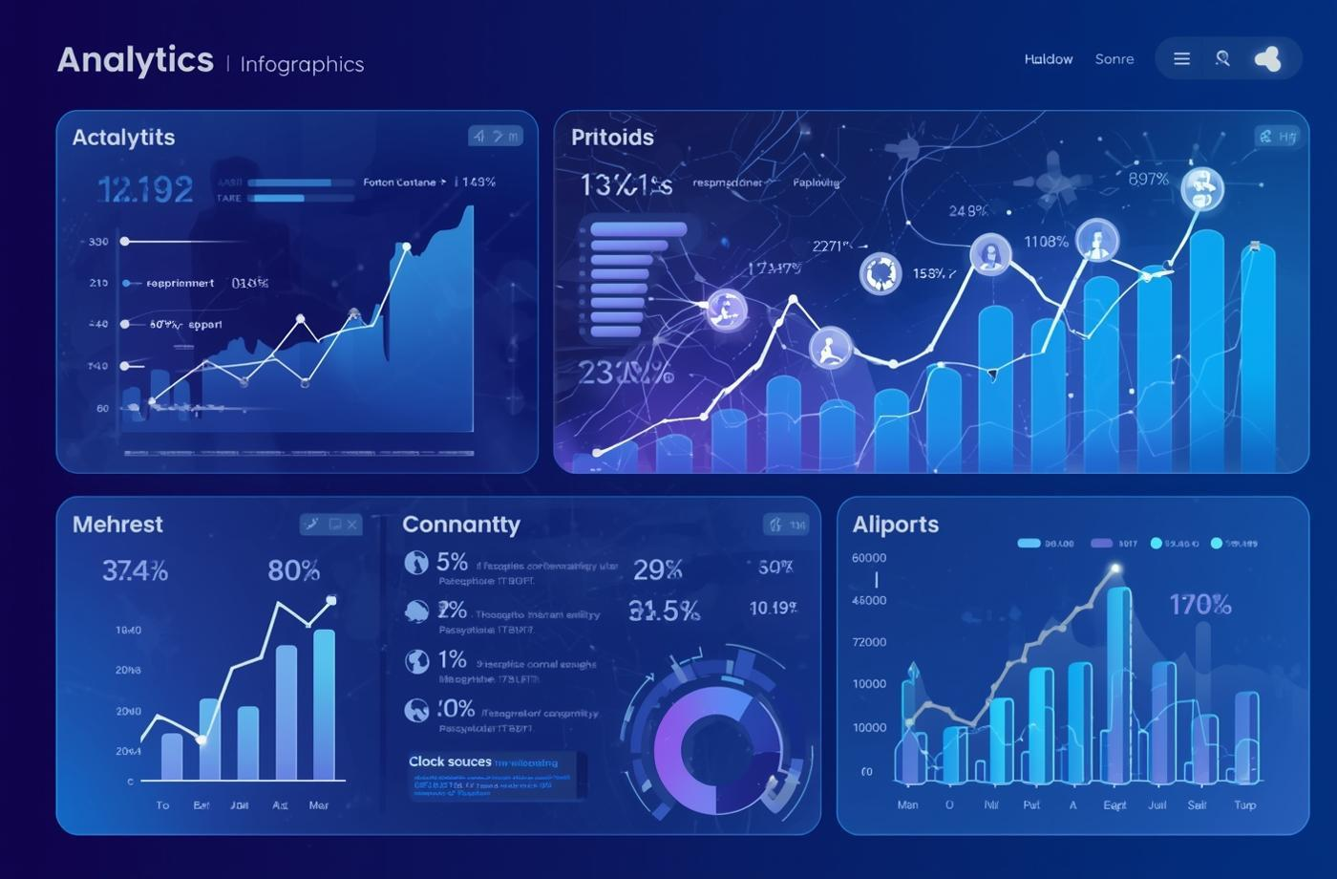
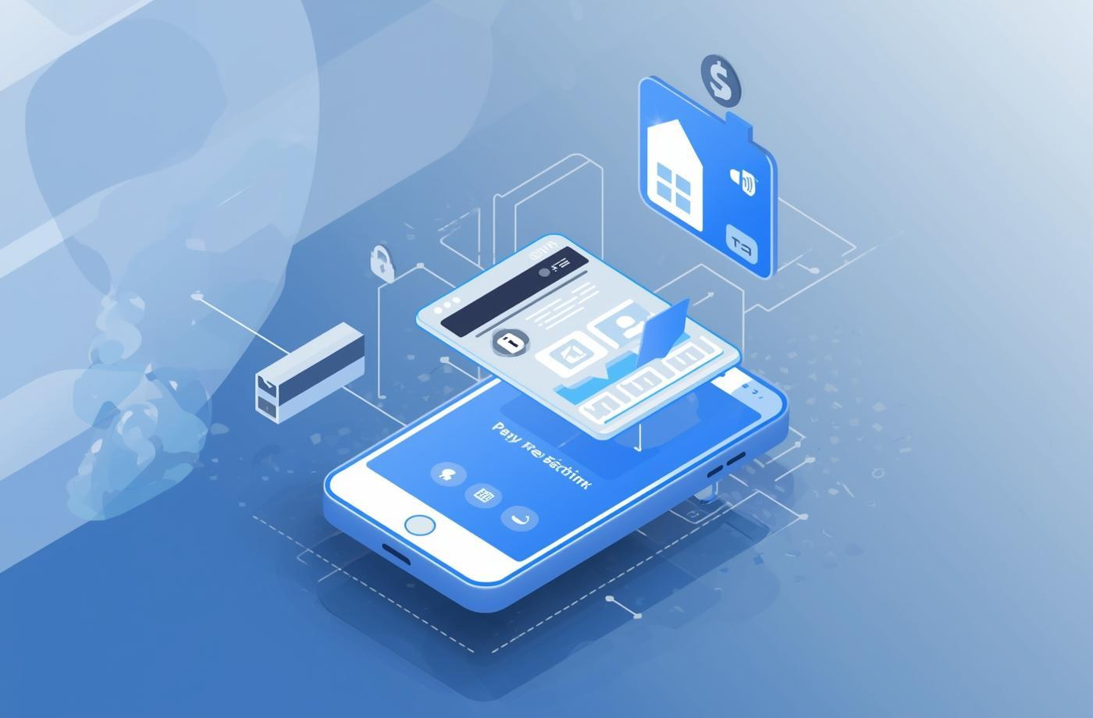
Future Enhancements for ITBIS
Explainable Risk Intelligence
Advanced Behavioral Analytics
Enterprise Telemetry Integration
  Utilize AI to provide personalized event suggestions based on user interests and past attendance.
  Smart reminders for upcoming events the user might be interested in.
  Continuous learning from feedback to refine future suggestions.
  Improve behavioral baselines and peer comparison.
  Visualize anomaly trends and severity over time.
  Evaluate detection quality and false-positive rates.
  Integrate authorized identity, endpoint, firewall, and SIEM sources.
  Normalize events into a consistent telemetry format.
  Apply secure connector configuration and access controls.

Slide 11
PROJECT OWNER
AYESHA FARHUNNISA J

Slide 12
PROJECT DEMONSTRATION
https://drive.google.com/file/d/1pEIMbL__Nxdrh6NSpsul9a5RHgztHLtH/view?usp=sharing

Slide 13
Q & A

Slide 14

Thank You

